Slide 1

E-retail factors for customer activation and retention
Presented by – Lavina Vaidya

Slide 2
CONTENTS :
Introduction
Problem statement
Steps used for analyzing data
Model selection
Cross validation
Saving model
Conclusion

Slide 3
INTRODUCTION
E-commerce is the buying and selling of goods and services online, without the need for physical interaction between the buyer and seller. It can also refer to the transfer of funds and data to facilitate these transactions. E-commerce is used in a wide range of industries, from retail to banking and finance.
Customer retention is the process of keeping customers happy and engaged with a business, product, or service. It involves building relationships with customers, providing them with quality products and services, and offering incentives to encourage them to remain loyal to the company. Customer retention strategies can include discounts, loyalty programs, personalized customer service, custom marketing campaigns, and more.

Slide 4
Customer satisfaction has emerged as one of the most important factors that guarantee the success of online store; it has been posited as a key stimulant of purchase, repurchase intentions and customer loyalty.
A comprehensive review of the literature, theories and models have been carried out to propose the models for customer activation and customer retention.
Five major factors that contributed to the success of an e-commerce store have been identified as: service quality, system quality, information quality, trust and net benefit.
The research furthermore investigated the factors that influence the online customers repeat purchase intention.
The combination of both utilitarian value and hedonistic values are needed to affect the repeat purchase intention (loyalty) positively.

Slide 5
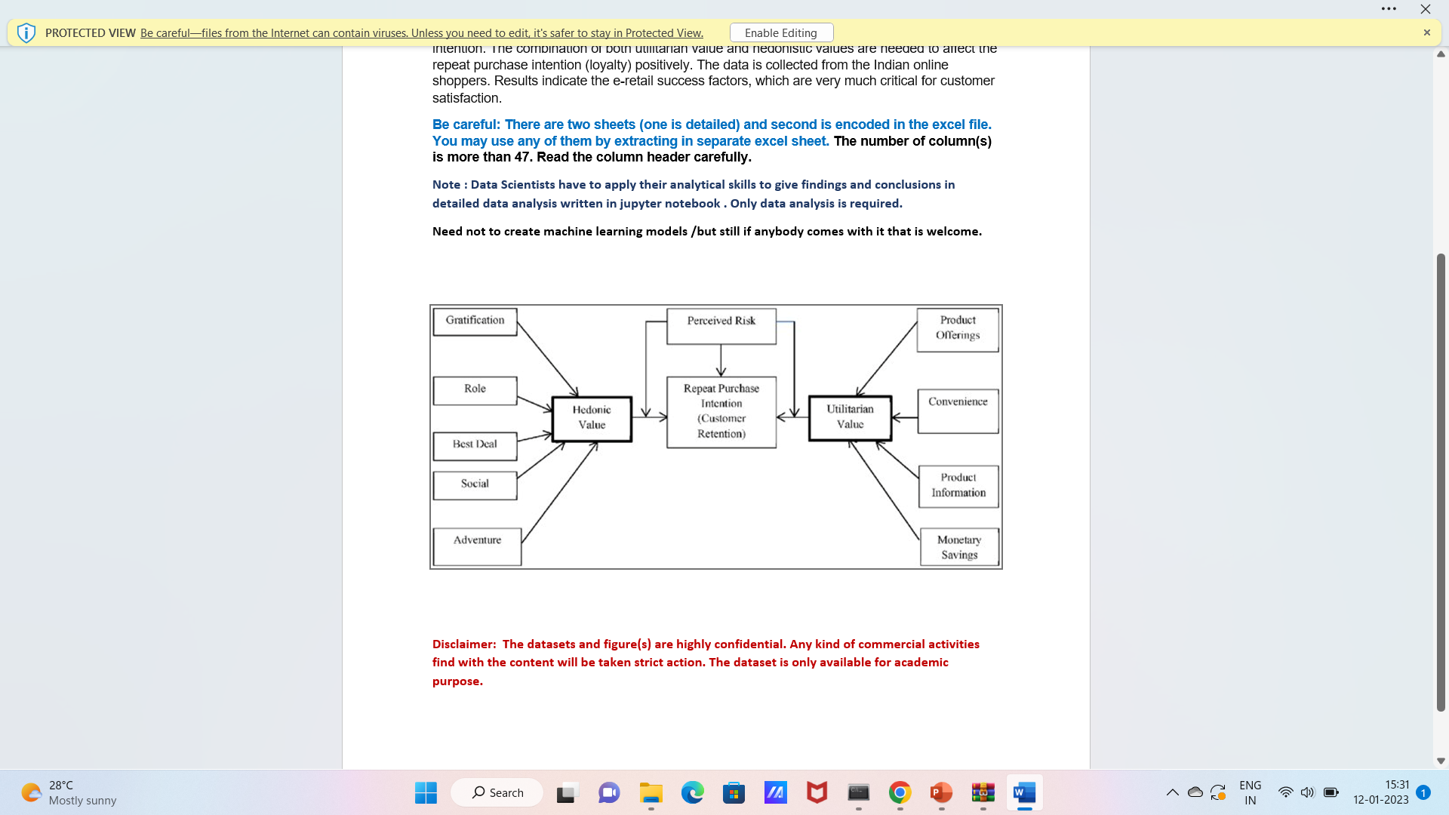
FACTORS THAT CONTRIBUTED TO THE SUCCESS OF AN E-COMMERCE

Slide 6
PROBLEM STATEMENT
The data is collected from the Indian online shoppers. Results indicate the e-retail success factors, which are very much critical for customer satisfaction.
We have a data of 71 factors (columns) which affect online business. We have to analysed the data find which factor give most impact on selling the product and find the way that customer retains for further shopping.
We have to analytical skills to give findings and conclusions in detailed data analysis written in jupyter notebook

Slide 7
STEPS USED FOR ANALYZING DATA
Importing libraries
Loading datset
EDA
Model selecting and analyzing
Making prediction
Parameter tuning
Testing model and analyzed model

Slide 8
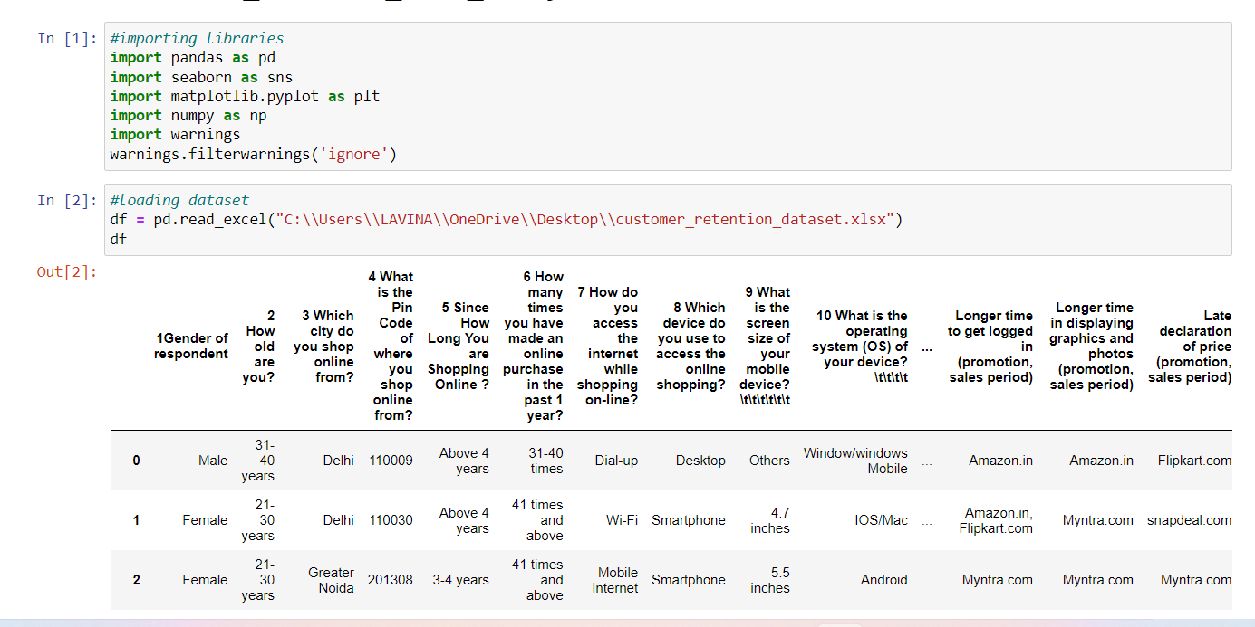
IMPORTING LIBRARIES AND LOADING DATASET

Slide 9
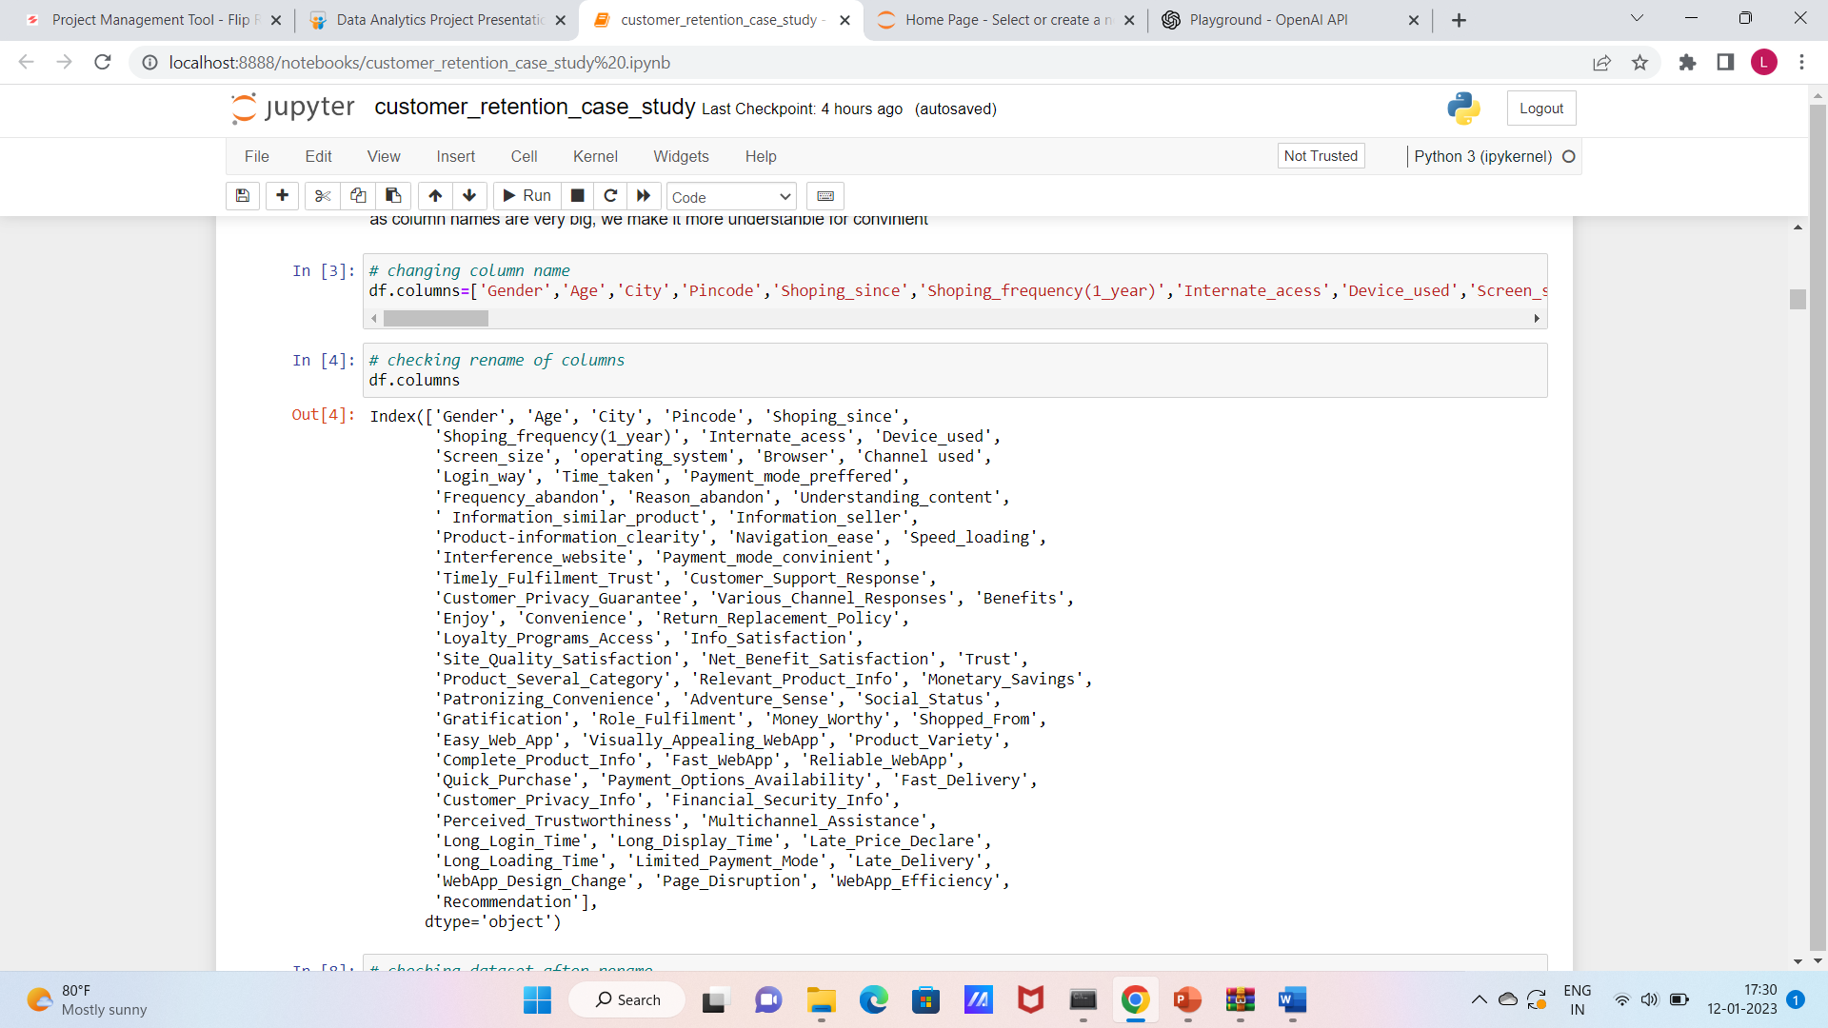
Here, we are observing that name of the colums are too big, so we changes the name for convenience
And new names of columns are

Slide 10
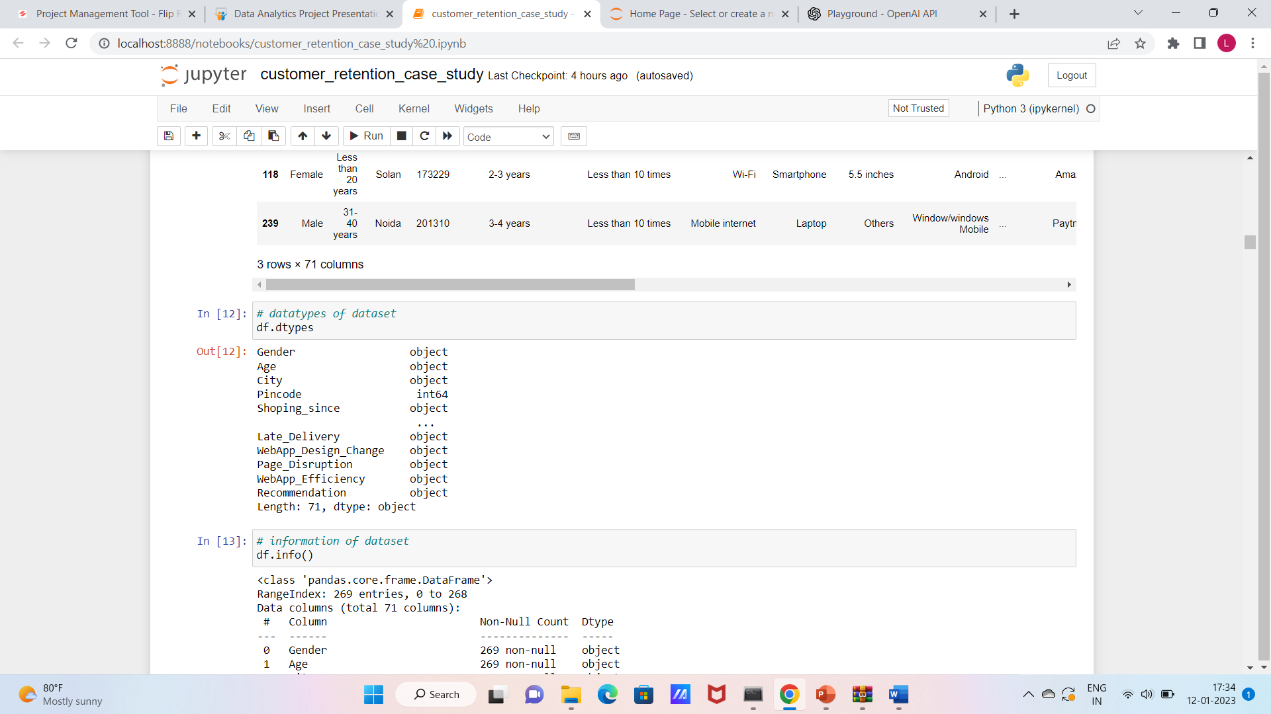
Checking datatypes of dataset
Here we observe that object datatype is present , for analyzing dataset we need to convert categorical data into numerical data

Slide 11
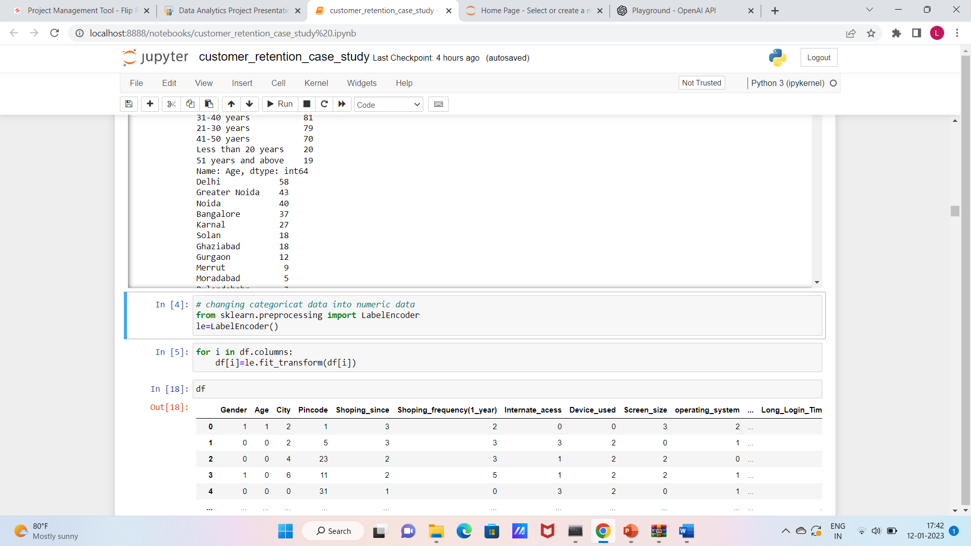
Changing categorical data into numerical data with the help of label encoder

Slide 12
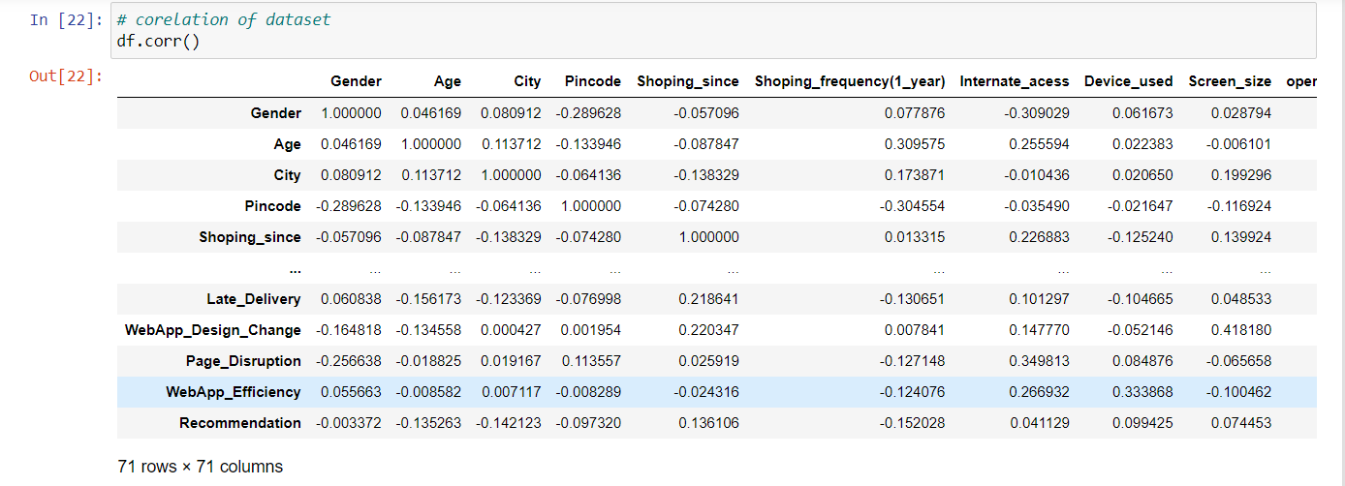
Statistical summary
Corelation of dataset

Slide 13
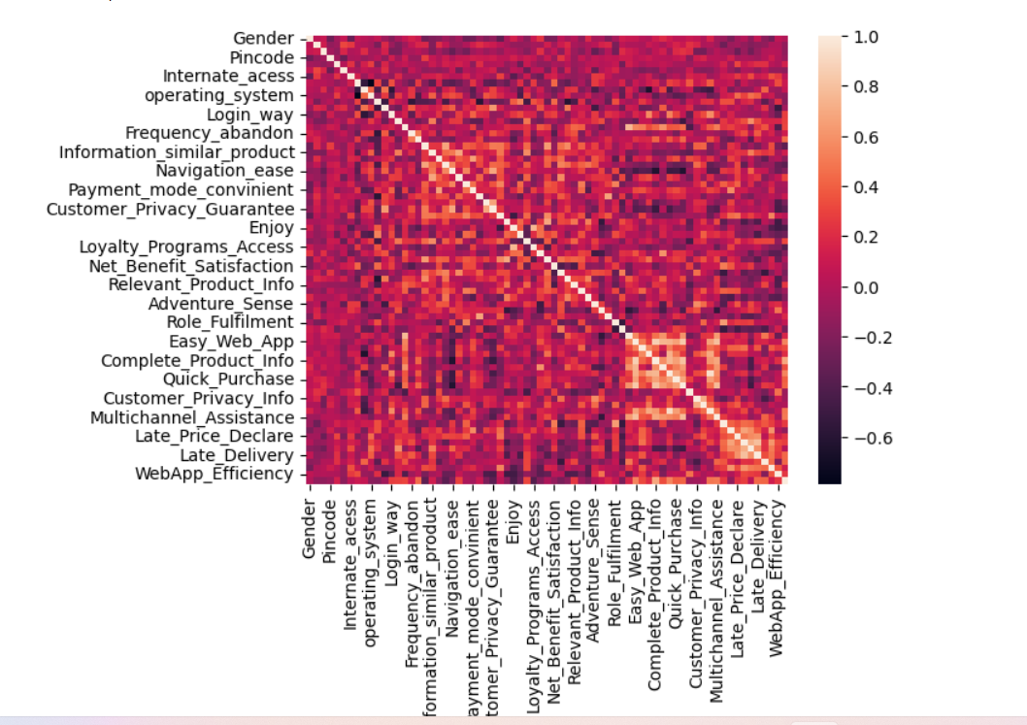
Visualization
Lighter colour shows higher corelation

Slide 14
Univariant analysis
Observations:
Gender : The number of gender of respondent for Female customers have high counts compared to Male customers. That is around 67% of female customers shopped online and only 32% of male customers shopped online
Age : The count is high for customers whose age is between 31-40 years and they shopped more from the online stores followed by the customers age between 21-30 years and 41-50 years
City : Most of the customers from the city Delhi, Greater Noida, Noida and Bangalore are used to shop online and the shopping count is high in these cities.
Shoping_since : Most of the customers found shopping online for more than 4 years and the count is high for the same followed by the customers shopping for 2-3 years.
Shoping_frequency(1_year) : In last 1 year, most of the customers were purchased online less than 10 times and only few of the customers purchased online 21-30 times.

Slide 15
6. Internate_acess : 70% of the customers access Mobile Internet for online purchase and 28% of the customers used WiFi to shop online and only 1% of the customers used Dial-up method to shop online
7. Screen_size : The count is high for others mobile screen size followed by 5.5 inches screen size and 5 inches screen size has least count. That means, the customers who have their mobile screen size other than mentioned inches shopped more online followed by 5.5 inches and the customers having mobile screen size 5 inches shopped very less8
8.operating_system : About 45% of the customers operationg system is Windows/windows Mobile and the count is also high for the same followed by the customers having Android O9
9.Browser : Most of the customers used Google chrome to access the website and only few of the customers used Opera and Mozilla Firefox to access the online shopping website.
10.Channel used : Around 85.50% of the customers used Search Engine channel to arrive at their favorite online store for the first time.

Slide 16
11. Device_used : Most of the customers used Smartphone device to access the online shopping and only few customers used Tablet to access the online shopping.
12.Login_way : Most of the customers used Search Engine and Via application to reach the online retail store after their first visit and also some customers used Detect URL to reach the online store which means these customers have downloaded their most favourite application to reach the online stores easily.
13.Time_taken : Many customers took more than 15 mins before making the purchase decision and some of the customers explored 6-10 mins.
14.Payment_mode_preffered : Most of the customers prefer to pay the bill using Credit/Debit cards and some of the customers prefer cash on delivery and very few of customers use E-wallets payment methods
15.Frequency_abandon : Most of the customers abandoned their shopping cart sometimes and some of the customers abandoned their shopping cart frequently.
16.Reason_abandon : Around 133 customers abandoned their bag due to some better alternative offer and 54 customers abandoned due to promo code not applicable.

Slide 17
17. Understanding_content : Around 90% of the customers agreed that the content on the website is easy to read and understand.
18. Information_similar_product : Around 77% of the customers agreed that the information on similar product to the one highlighted is important for product comparison.
19.Information_seller: About 70% of the customers agreed that complete information on listed seller and product being offered is important for purchase decision.
20. Product-information_clearity : 89% of the customers agreed that all relevant information on listed products must be stated clearly and only 11% of the customers disagreed with it
21. Navigation_ease : 91% of the customers agreed that ease of navigation in website helps them more
22. Speed_loading : Most of the customers agreed that they have no issues with the loading and processing speed.

Slide 18
23.Interference_website : 87% of the customers agreed with user friendly website interface . Creating new user friendly websites will impact on customers to shop more online . By doing this customers don't have to work around much and overall shoping experience would be smooth.
24. Payment_mode_convinient : 87% of the customers agreed with user friendly website interface . Creating new user friendly websites will impact on customers to shop more online . By doing this customers don't have to work around much and overall shoping experience would be smooth.
25. Timely_Fulfilment_Trust : 84% of the customers trusted that the online retail store will fulfill its part of the transaction at the stipulated time.
26.Customer_Support_Response : The count is high for the customers who agreed the empathy towards the customers in the online shopping website is very helpful . If the online shopping companies ready to assist with customers queries then there will be benefit for both company and the customers.

Slide 19
27. Customer_Privacy_Guarantee :Being able to guarantee the privacy of the customer also got 90% agree. That is the customers are concerned about the unauthorized access to their data. Protecting used privacy will enablestores to drive more revenue and gain more customers. Only 9.67% of the customers in neutral state which means they are in confusion whether to agree with this method or not
28. Various_Channel_Responses : Most of the customers agreed to offering a wide variety of listed product in several category and the count is high for the same.
29. Benefits : About 70% of the customers agreed that the online shopping gives monetary benefits and discounts
30. Enjoy : 54% of the customers agreed that they enjoys online shoppings and only 18% of the customers disagreed
31. Convenience : 83% of the customers agreed that shopping online is convenient and flexible and 12% of the customers are indifferent which means either they are agreed to this or disagreed and only 5% of the customers completely disagreed with it.

Slide 20
32. Return_Replacement_Policy : Around 73% of the customers strongly agree and 19% of the customers agree that the return and replacement policy helps them making purchase decision. It is evident from the fact that the customers actually not liking the products completely, they are just purchasing the products and returning them in case of any dissatisfaction. So it is important for the online shopping websites to make easy return and replacement policy if they want to retain their customers
33. Loyalty_Programs_Access : 66% of the customers agrees that gaining access to loyalty programs is a benefit of shopping online
34. Info_Satisfaction : 79% of the customers agreed that displaying quality information on the website improves satisfaction of customers since they believe that displaying quality information have significant association with customer satisfaction. And remaining 21% of the customers are in neutral situation
35. Site_Quality_Satisfaction : 97% of the customers agreed that they are satisfied while shopping on a good quality website and 3% of the customers disagreed with it

Slide 21
36. Net_Benefit_Satisfaction : About 81% of the customers agreed that the net benefit derived from shopping online can lead to users satisfaction
37. Trust : 88.85% agreed that the customers satisfaction cannot exists without trust. The companies must learn how to manage the customers trust
38. Product_Several_Category: The count is high for the customers who agreed that the responsiveness, availability of several communication channels will help them more while shopping online which means if one channel is not available thn customers can easily reach out to other channel to fulfill their benefits
39. Relevant_Product_Info : Around 86% of the customers would like to have provision of complete and relevant product information in the online shopping website.
40. Monetary_Savings : 82.90% customers agreed to receive monetary savings . The ecommerce company need to know that the best way to sell online is to make the consumer feel that he is saving money doing so. And not just feel, online shopping should result in a lot of saving for the consumer. This saving would automatically get converted into trust and brand equity for the seller. To do this the online companies should offer the best deals and bargains to the consumer through social platforms . If the retailers gives some discounted prices then the customers can make money savings.

Slide 22
41. Patronizing_Convenience : 71% of the customers agreed that the Convenience of patronizing the online retailer
42. Adventure_Sense : 57% of the customers agreed that shopping on the website gives the sense of adventure. The adventures in the shopping websites gives positive activity to experience an amplified enjoyment to the customers while shopping on websites
43. Social_Status : Around 39.78% customers agreed that shopping on prefered e-tailer enhances the social status of the customers
44. Gratification : 48% of the customers agreed that they felt gratified while shopping on their favourite e-tailer
45. Role_Fulfilment : agree and indifferent have same number
46. Money_Worthy : Around 86% of the customers agreed that they are getting value for their money while shopping and 14% of the customers thinks either they are wasting
47. Shopped_From : 47% of the customers agreed that shopping on the website helps them fulfilling certain roles and 33% of the customers are in confusion whether to agree of disagree and only 20% of the customers disagrees with it.

Slide 23
48. Easy_Web_App : Most of the people shopped from Amazon.in, Flipkart.com, Paytm.com, Myntra.com, Snapdeal.com companies and they think that it is easy to use website or application
49. Visually_Appealing_WebApp : Amazon.in and Flipkart.com have high visual appealing web-page layout compared to others.
50. Product_Variety : 48% of the customers says that amazon and flipkart shows wide variety of products in their shopping websites
51. Complete_Product_Info: 37% of the customers liked amazon and flipkart in displaying complete and relevant information of the products.
52. Fast_WebApp : Around 51 customers says that Amazon.in is the fast loading website and application and they liked it. About 44 customers liked the web speed of both amazon and paytm followed by amazon and flipkart.
53. Reliable_WebApp : The count is high for amazon followed by amazon and flipkart which means most of the customers liked the reliability of website or application in amazon and flipkart.

Slide 24
54. Quick_Purchase : Most of the customers likes Amazon's quickness to complete the purchase followed by Flipkart's and only few of the customers likes Myntra website.
55. Payment_Options_Availability : In Amazon and flipkart websites there are several payment options availabel compared to the other shopping websites.
56. Fast_Delivery : Most of the customers liked Amazon's delivery speed followed by flipkart and snapdeal.
57. Customer_Privacy_Info : Most of the customers trusts Amazon followed by flipkart in terms of keeping the privacy of their data information.
58. Financial_Security_Info : The count is high for the customers who belives that amazon website keeps their financial information secreate also the customers trusts flipkart, Myntra, Snapdeal and paytm in terms of keeping their financial information secured.
59. Perceived_Trustworthiness : Most of the customers believed that Amazon has perceived trustworthiness compared to others. Apart from this customers believed that flipkart and Myntra also have perceived trustworthness.

Slide 25
60. Multichannel_Assistance : Most of the customers like Amazone interms of presence of online assistance through multi-channel followed by flipkart, Myntra and snapdeal.
61. Long_Login_Time : Most of the customers agreed that Amazon takes longer time to get logged them in.
62. Long_Display_Time : Customers believes that Amazon and flipkart takes longer time in display the graphics and photos in sales period.
63. Late_Price_Declare : Myntra and paytm have late declaration of price in promotion/sales period compared to others.
64. Long_Loading_Time : Myntra and paytm takes longer page loading time.
65. Limited_Payment_Mode : Snapdeal.com has limited mode of payment on most products followed by Amazon.in.

Slide 26
66. Late_Delivery : In terms of time taken in product delivery Paytm has highest count followed by Snapdeal.com.
67. WebApp_Design_Change : Most of the customers disliked change in website/Application design on amazon followed by paytm.
68. Page_Disruption : Most of the customers disliked frequent disruption when moving from one page to another on amazon , Myntra and snapdeal.
69. WebApp_Efficiency : Most of the customers believes that Amazon and flipkart website is as efficient as before.
70.Recommendation : Most of the customers would like to recommend amazon retailer to a friend followed by flipkart.

Slide 27
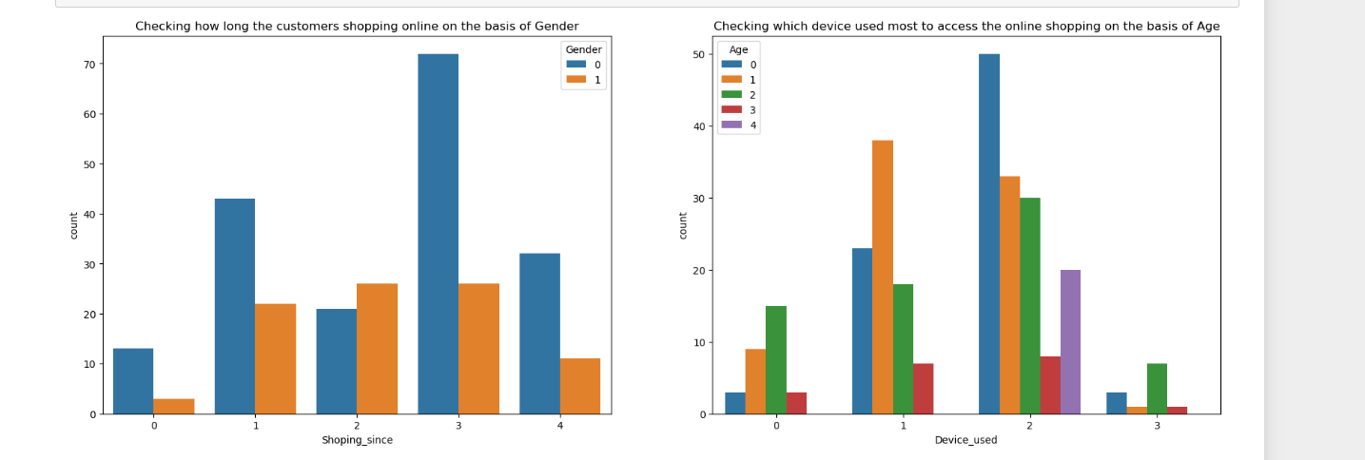
Bivariant analysis
Most of the female customers shopped online from more than 4 years and the count is also high for females who shopped from 2-3 year. And only few male customers shop online more than 4 years. Which means the female customers are more enthusiastic to buy products from the online shopping websites.
Many customers whose age between 31-40 years and 21-30 years used Smartphones followed by Laptops to access the online shopping websites.

Slide 28
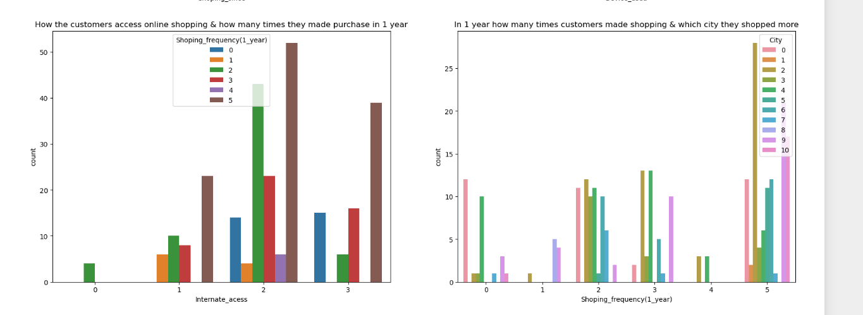
Most of the customers access the shopping websites more than 31-40 times in 1 year through Mobile Internet to shop the products also most of the customers who used mobile internet to access the online shopping website made online purchase less than 10 times in a year . And only few of the customers used WiFi network to access the shopping store.
Most of the customers used ecommerce websites less than 10 times in a year from the city Delhi to shop the products.

Slide 29
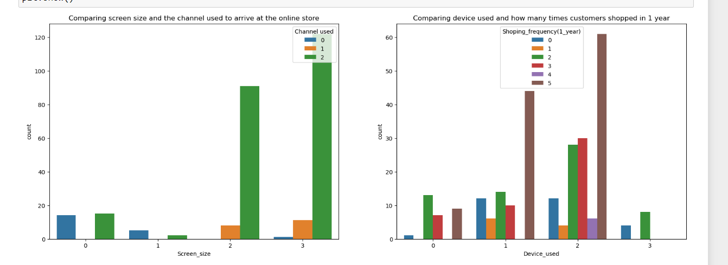
The customers having their mobile screen size say 6 inches have followed search engine channel to arrive at their favorite online store for the first time. Also the customers who have their screen size 5.5 inches also used search engine channel to access the online shopping store.
Most of the customers used Smartphones 31-40 times in an year to access the ecommerce websites to shop the products.

Slide 30
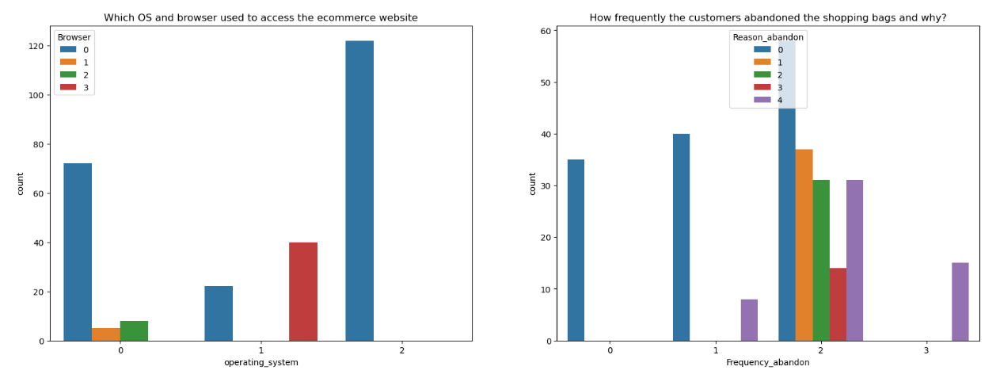
Many customers having windows operating system in their device ran Google chrome to access the ecommerce shopping websites and some of the customers having IOS/Mac operation system used Google chrome as well as Safari to reach the online shopping store.
Due to Lack of trust on the ecommerce websites, sometimes most of the customers abandoned the websites and some of the customers abandoned the shopping website due to the promo code not applicable which means, if the product is having the special price or some catalogue price rule is applicable on it. Then coupon code should not be applicable on the products.

Slide 31
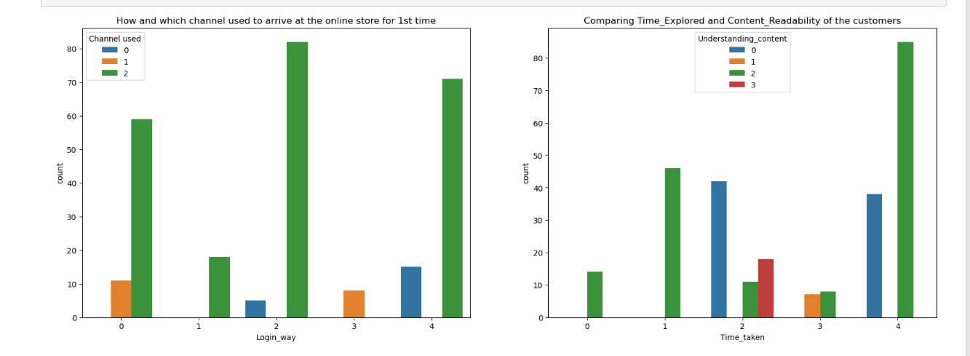
Search engine is the most used channel by the customers to arrive their favourite store for the first time and alter visit the website for the first time, most of them used the same channel to reach the online retail store to reshopping the product.
Most of the customers agreed that the content on the wegsite is easy to read and understand also they explored more than 15 mins before making the purchase decision and some of the customers strongly disagreed that the content is not good and they explored 6-10 mins before making the purchase decision . So ecommerce websites should enable some images and if should contain clear structure, so that the customers can easily read and understand the content of the product.

Slide 32
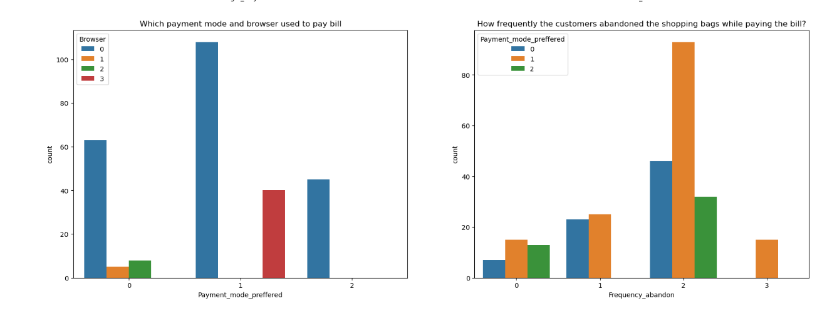
Most of the customers used google chrome to reach the websites and they preferred to pay their product price using Credit/Debit cards and only few of the customers used Safari browser to reach the e-retail websites.
Sometimes the customers used to abandon their selected items and wants to leave without making payment and most of them making the payment using E-wallets methods.

Slide 33
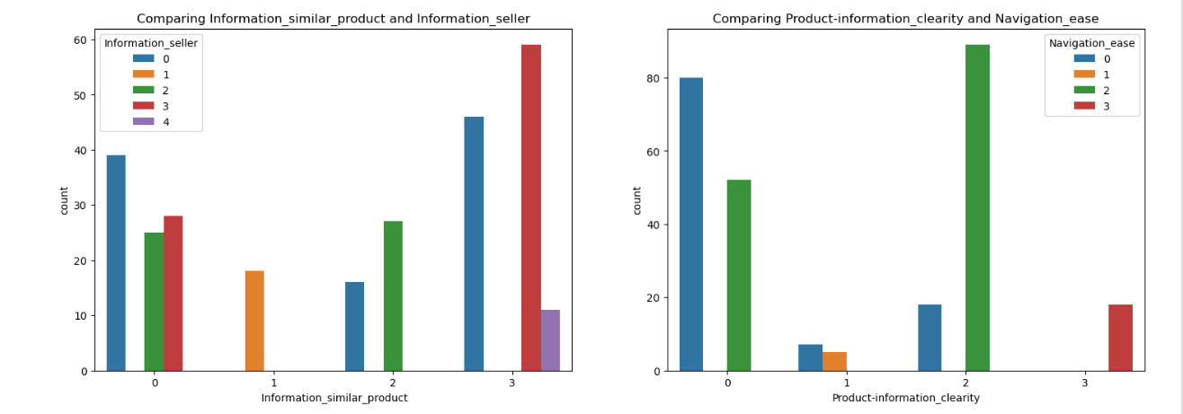
Most of the customers agreed that the information on similar product to the one highlighted is important for product comparison and also Complete information on listed seller and product being offered is important for purchase decision in order to buy a product, the ecommerce website must give the complete information about the product and seller information then only the customers can compare the product costs and its details in different websites and they tend to buy that particular product in a particular website.
Around 90% of the customers agreed that they should be able to navigate the website easily and the products information in the website must be clearly stated their uses, lifetime, benefits etc. Then only more customers tend to buy those products and can shop easily.

Slide 34
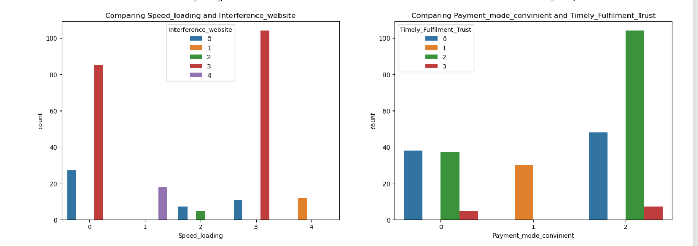
Most of the customers agreed with the user friendly interface of the websites which can be easily loaded and processed also these websites loading and processing capacity is very fast so that the customers like to shop in ecommerce websites if these websites do not have this much of loading and processing speed then customers don't want to buy the products in this website and they tend to other websites or other options rather than this .
Most of the customers agree to the trust that the online retail stores will fuilfil its part of the transaction at the stipulated time also most of them very happy with the convenient payment modes given by the websites in other words, the websites must provide all the possible ways of payment methods then only the customers shop frequently all the time the mode of the payment for customers may not possible sometimes they may choose case on delivery . So if the retailers provides all type of payment methods then the customers can easily make the payment also it enhances the sales of the ecommerce sites. And the transaction must also be given with some stipulated time otherwise the payments may be failed so they've to provide minimum amount of time which need to be fixed for all.

Slide 35
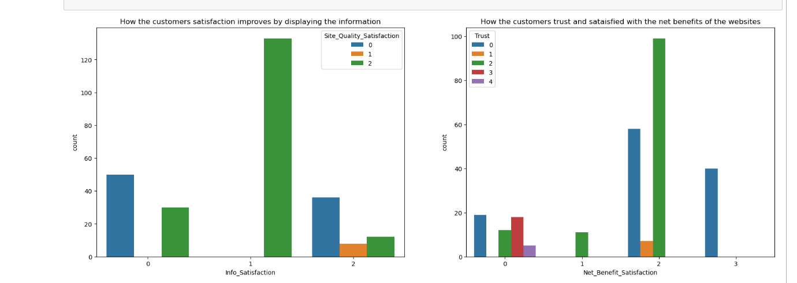
Many customers agreed that displaying quality information on the website improves satisfaction of customers since they believe that displaying quality information have significant association with customer satisfaction and they are satisfied and happy while shopping on good quality websites .
Most of the customers agreed that net Benefit derived from shopping online can lead to users' satisfaction also they believe that user satisfaction cannot exist without trust. The e-tailer should provide crediting points so that the customers tend to buy frequently in order to gain points. Trust is also a major factor for customers to decide whether to buy products from online stores or not also trust helps reduce uncertainly when the degree of familarity between the customer and transaction security mechanism is insufficient.

Slide 36
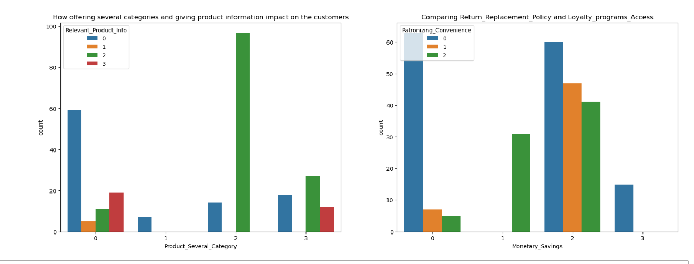
The customers are more likely to purchase on the same websites if that website offers them a wide variety of products in several category and giving relevant information about the products . Having multiple product lines may allow to grow the ecommerce business and finding accurate and up-to-date information of the product must be stated clearly in the website so that the customers can buy the products without any confusion.
In this digital and competitive world, everyone wants to save money , the ecommerce company need to know that the best way to sell online is to make the consumer feel that he is saving money doing so, And not just feel, online shopping should result in a lot of saving for the consumer. This saving would automatically get converted into trust and brand equity for the seller.

Slide 37
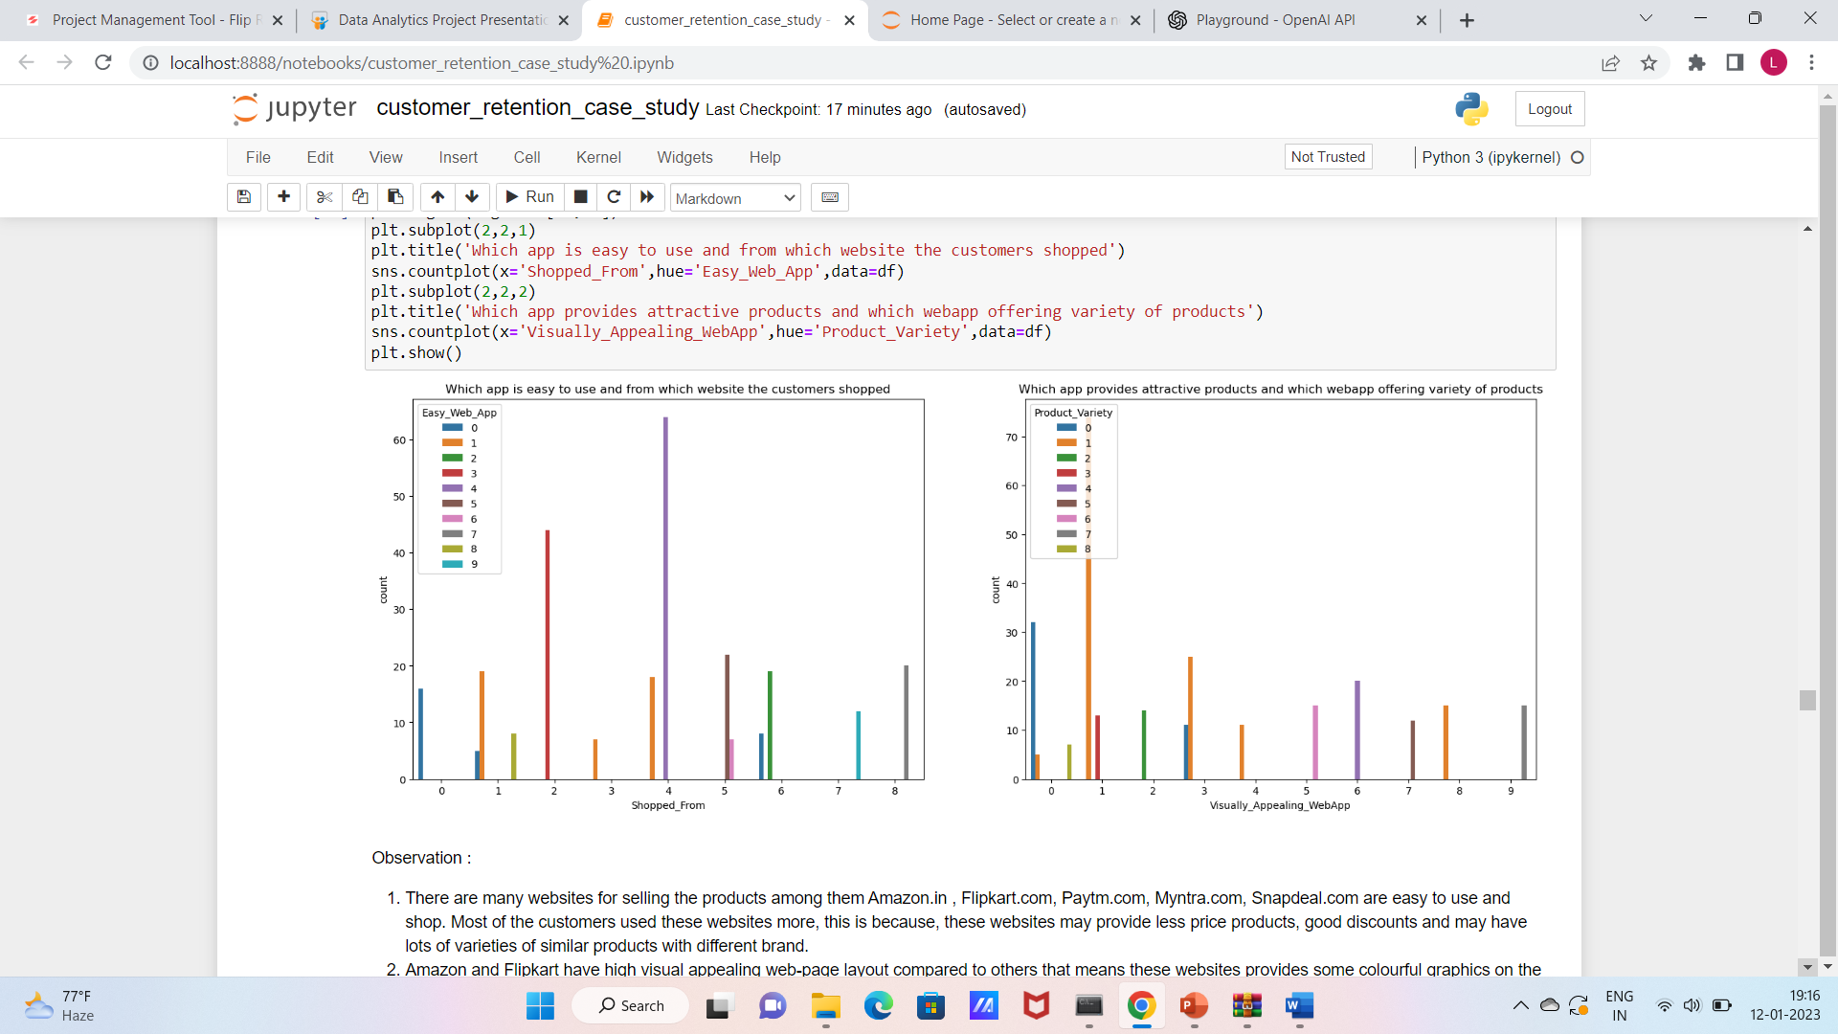
There are many websites for selling the products among them Amazon.in , Flipkart.com, Paytm.com, Myntra.com, Snapdeal.com are easy to use and shop. Most of the customers used these websites more, this is because, these websites may provide less price products, good discounts and may have lots of varieties of similar products with different brand.
Amazon and Flipkart have high visual appealing web-page layout compared to others that means these websites provides some colourful graphics on the hompage. The more people find the website attractive, there are higher chances that they will stay a little longer in that website, also these websites provide wild variety of products in an attractive manner which makes the customers to buy the product.

Slide 38
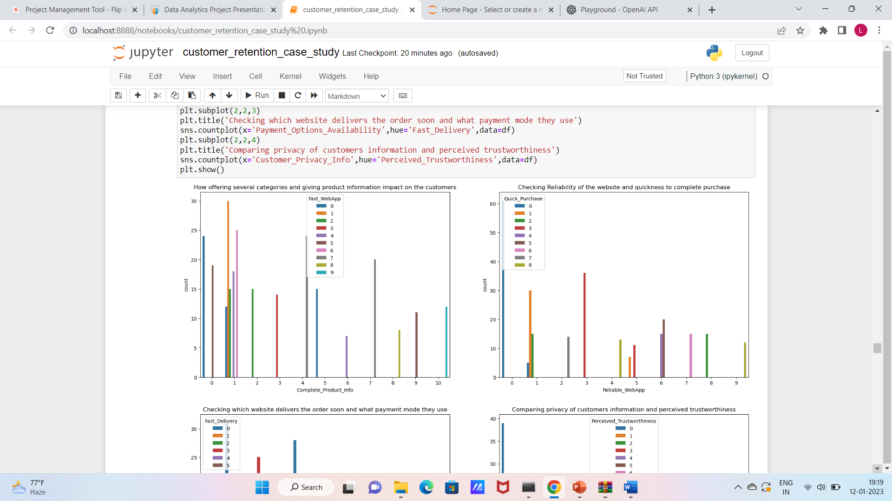
From the plot we can visualize that the amazon and flipkart websites gives complete and relevant information and these websites have no issue with the server and most of the customer liked the web speed of both amazon and flipkart.
From the plot we can notice amazon site is more reliable and most of the customers complete their purchase on amazon very quickly.

Slide 39
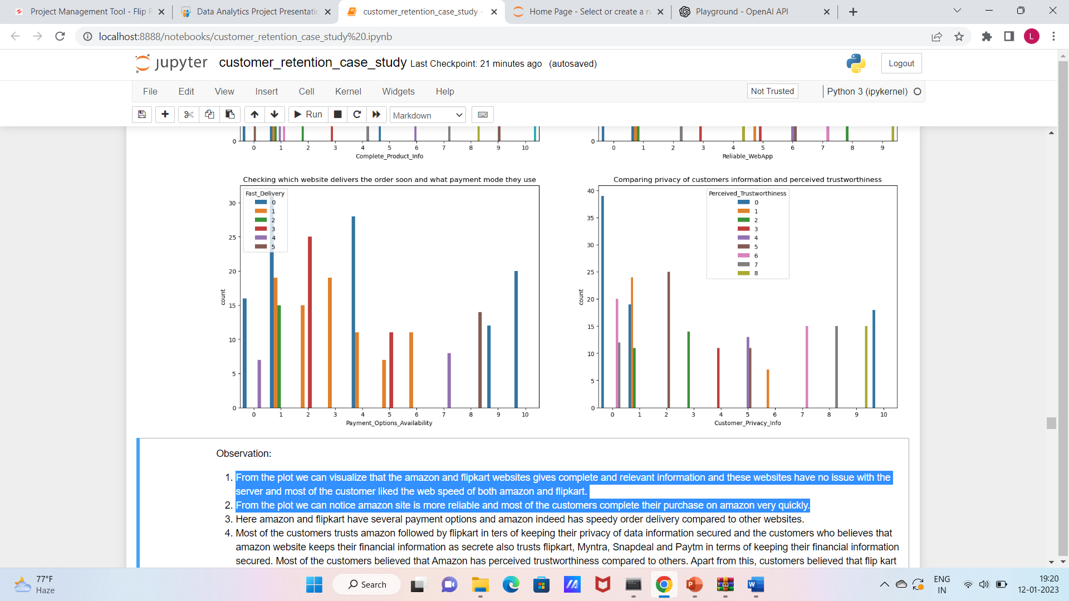
Here amazon and flipkart have several payment options and amazon indeed has speedy order delivery compared to other websites.
Most of the customers trusts amazon followed by flipkart in ters of keeping their privacy of data information secured and the customers who believes that amazon website keeps their financial information as secrete also trusts flipkart, Myntra, Snapdeal and Paytm in terms of keeping their financial information secured. Most of the customers believed that Amazon has perceived trustworthiness compared to others. Apart from this, customers believed that flip kart and Myntra also have perceived trustworthiness.

Slide 40
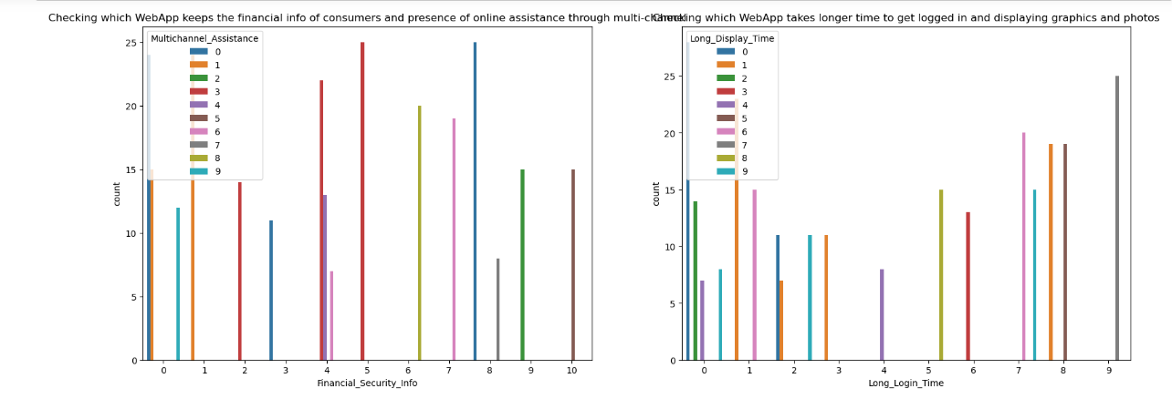
The customers trusts that amazon and flipkart keeps their financial information private and they never share any type of information to others.
Amazon takes longer time to displaying graphics and photos

Slide 41
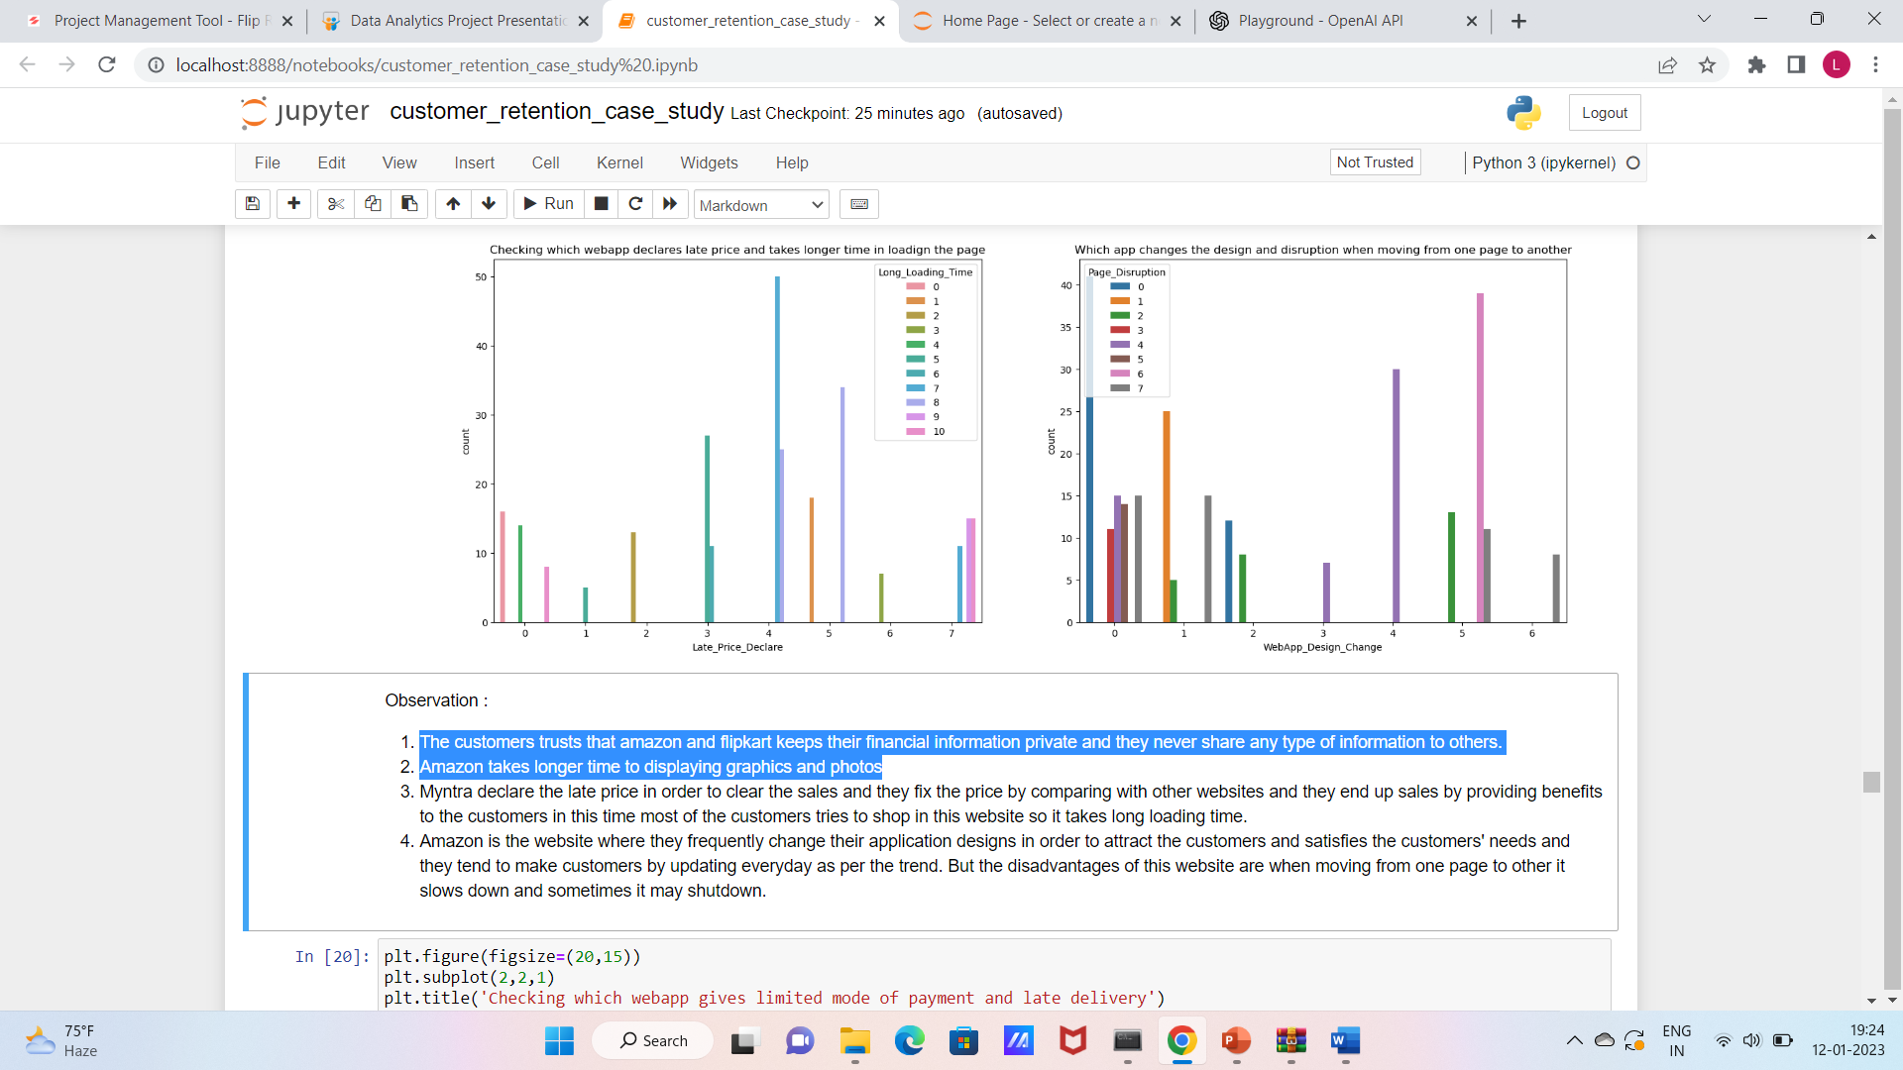
Myntra declare the late price in order to clear the sales and they fix the price by comparing with other websites and they end up sales by providing benefits to the customers in this time most of the customers tries to shop in this website so it takes long loading time.
Amazon is the website where they frequently change their application designs in order to attract the customers and satisfies the customers' needs and they tend to make customers by updating everyday as per the trend. But the disadvantages of this website are when moving from one page to other it slows down and sometimes it may shutdown.

Slide 42
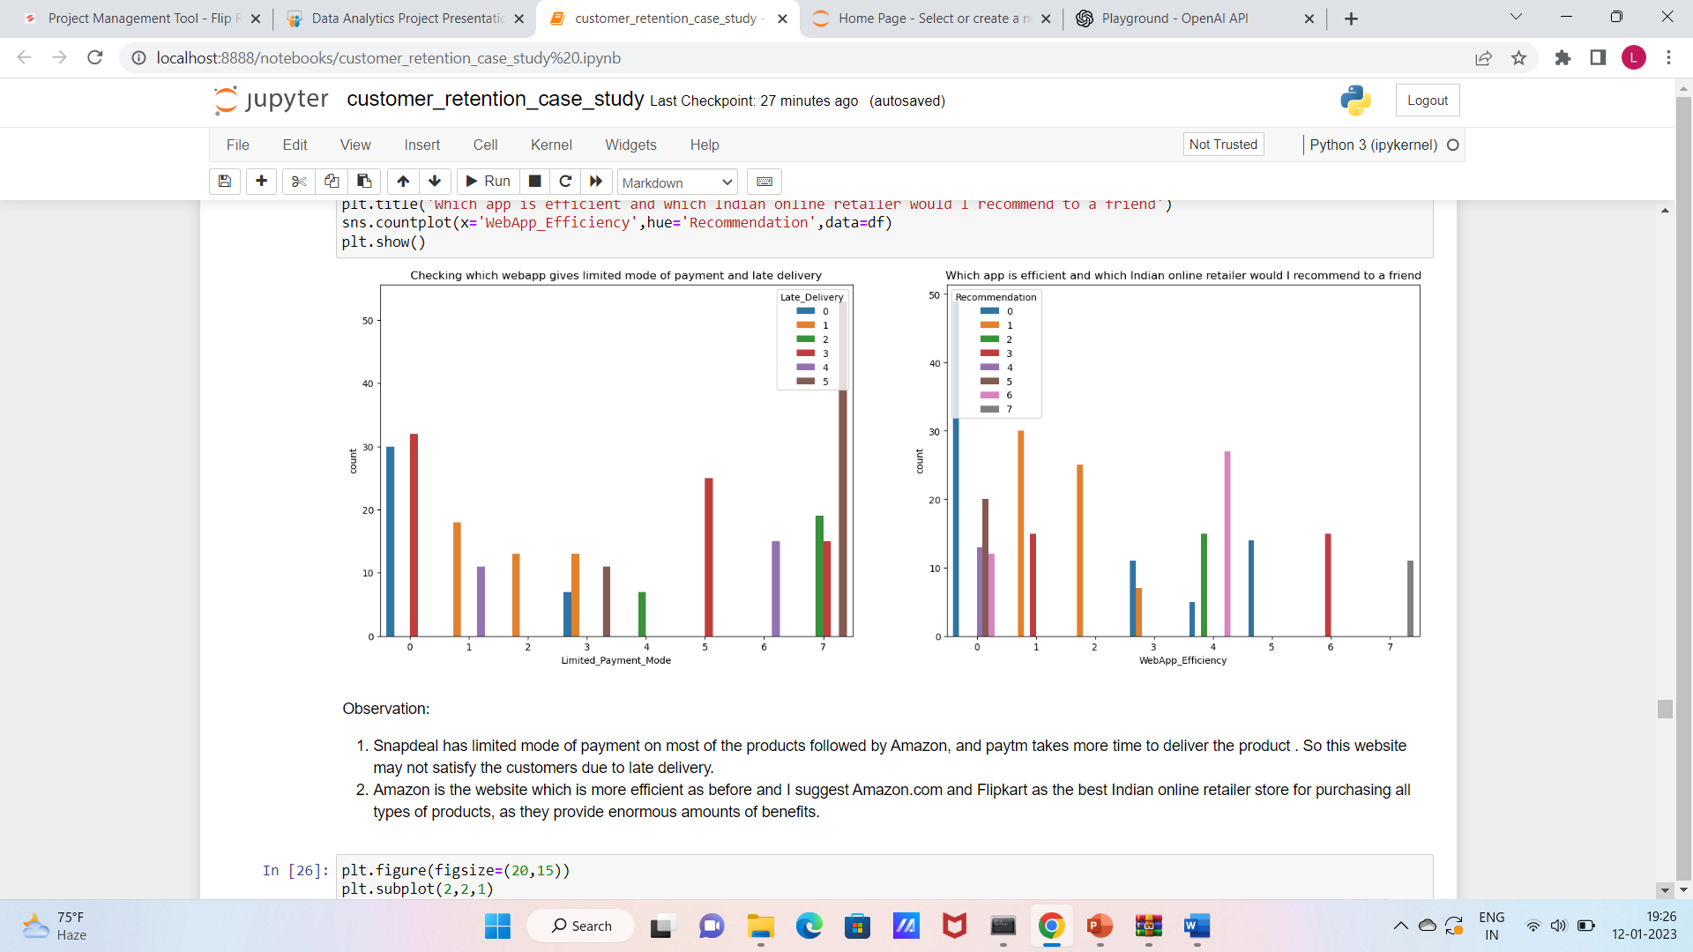
Snapdeal has limited mode of payment on most of the products followed by Amazon, and paytm takes more time to deliver the product . So this website may not satisfy the customers due to late delivery.
Amazon is the website which is more efficient as before and I suggest Amazon.com and Flipkart as the best Indian online retailer store for purchasing all types of products, as they provide enormous amounts of benefits.

Slide 43
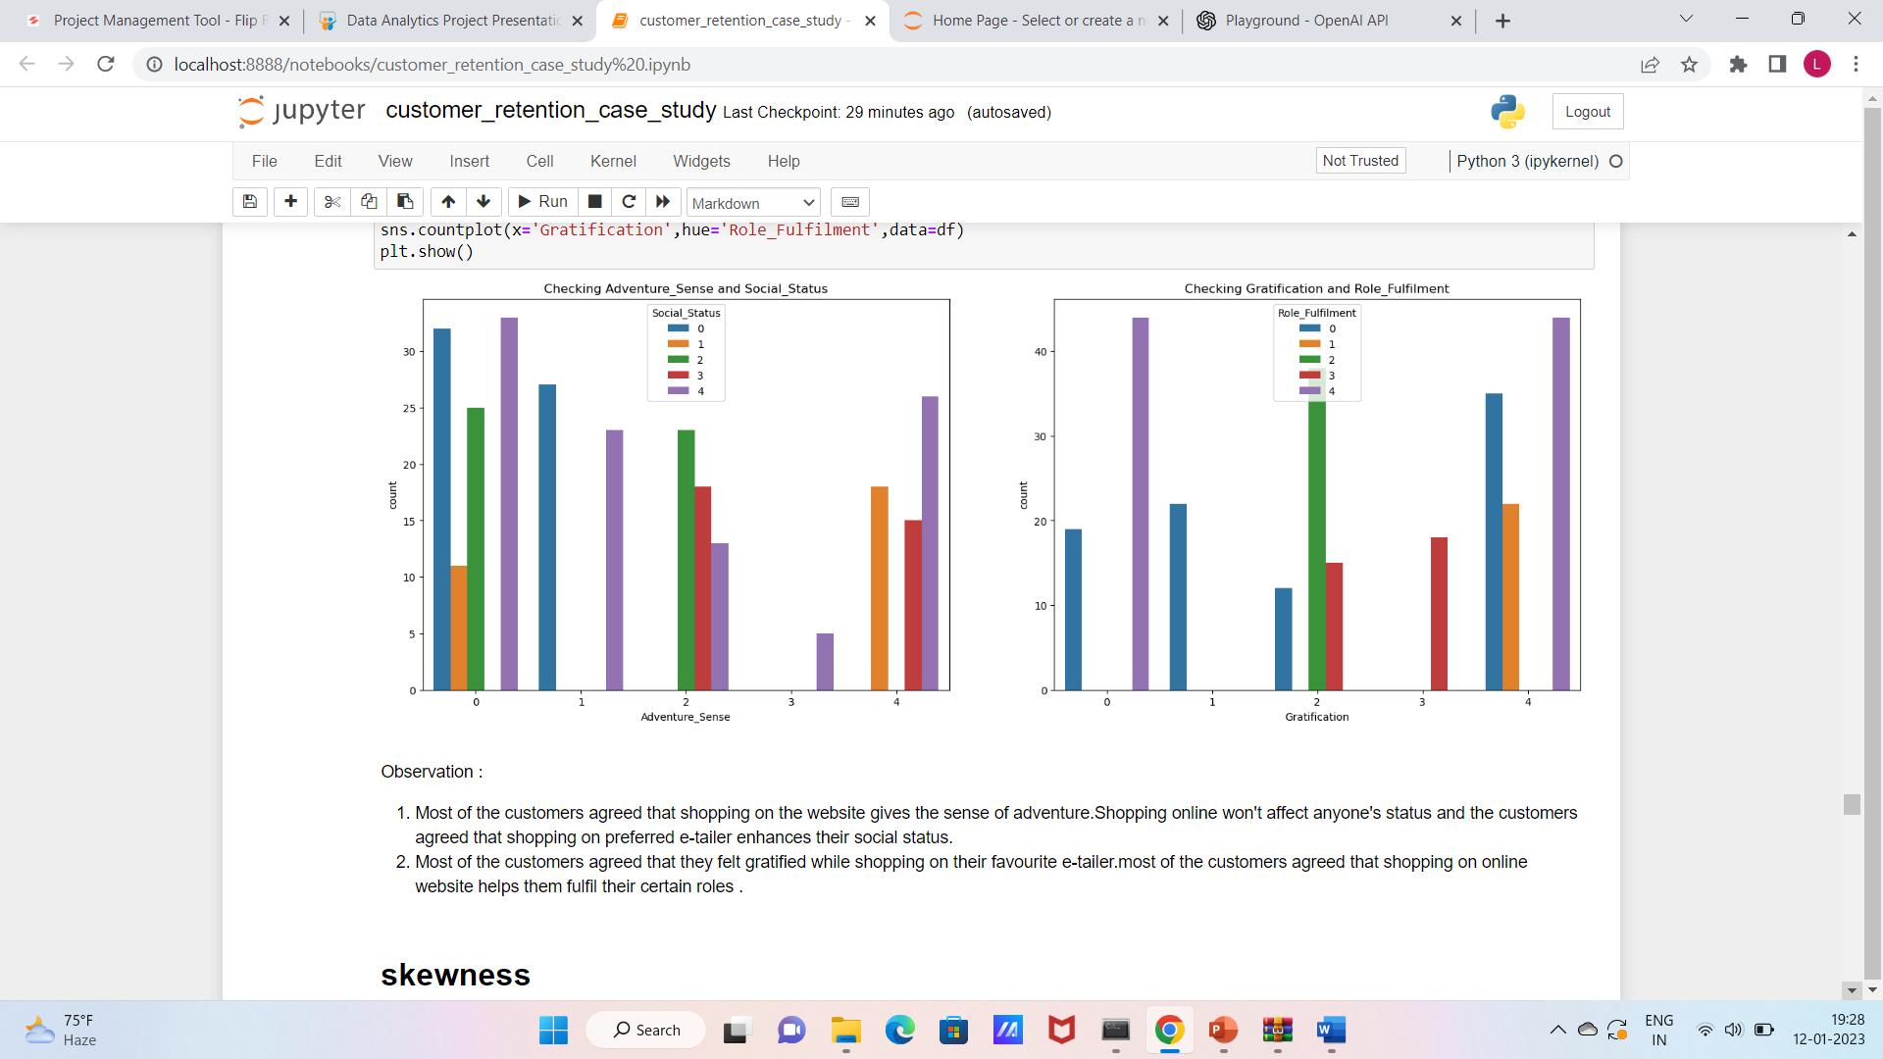
Most of the customers agreed that shopping on the website gives the sense of adventure.Shopping online won't affect anyone's status and the customers agreed that shopping on preferred e-tailer enhances their social status.
Most of the customers agreed that they felt gratified while shopping on their favourite e-tailer.most of the customers agreed that shopping on online website helps them fulfil their certain roles .

Slide 44
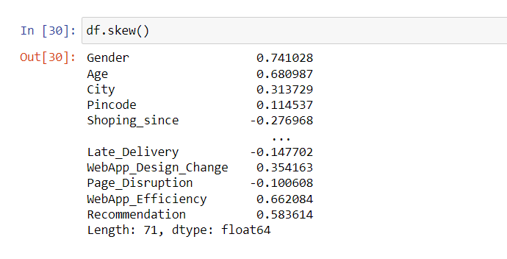
SKEWNESS
Observation:
Skewness is present in most of the column.
We check zscore and IQR method to remove skewness and find that zscore is best method because number of dropping rows are less than IQR.
Hence, we use zscore method to remove skewnesss.

Slide 45
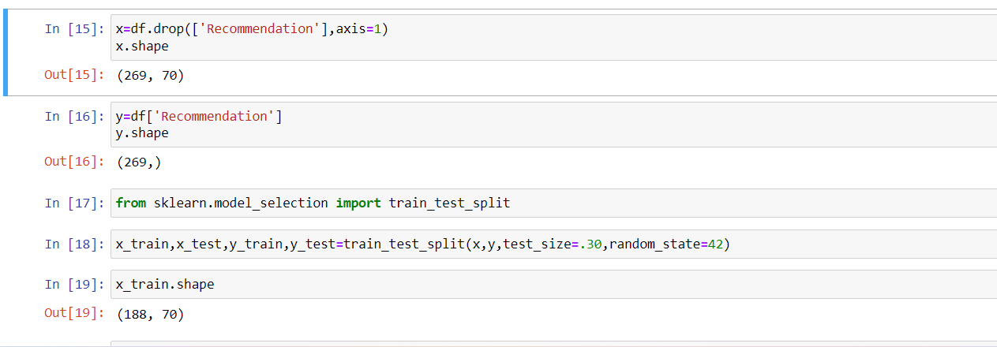
Splitting data in x and y
We take recommendation as output column. And split the data in input and output column.
Take the test size 30% and 70% is training size

Slide 46
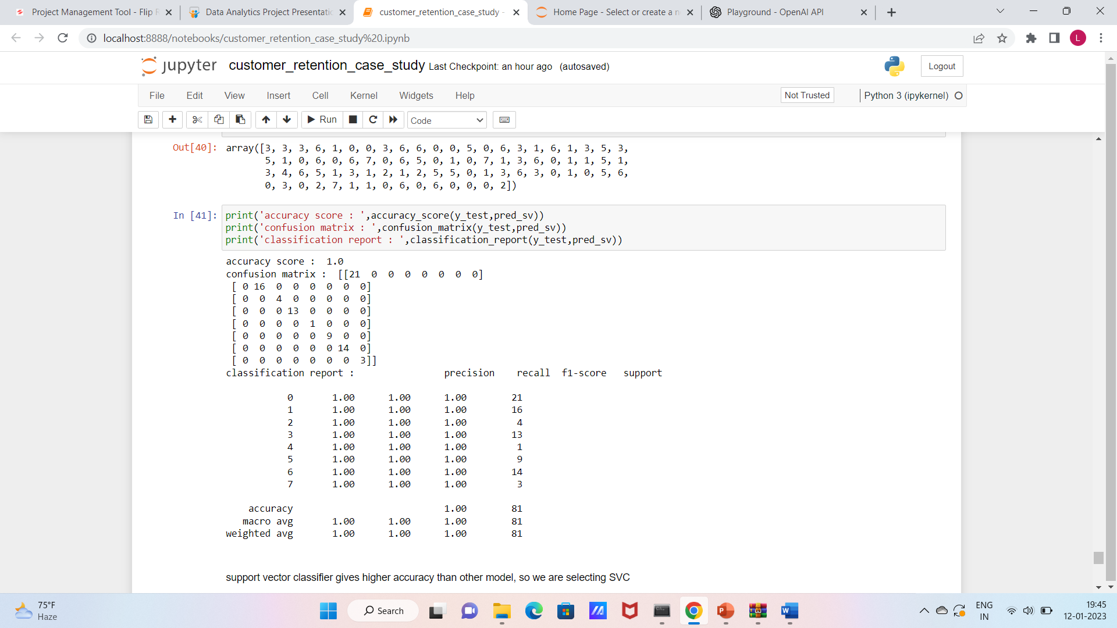
Model selection
After applying various classifier it it find that Support vector classifier work best for this dataset

Slide 47
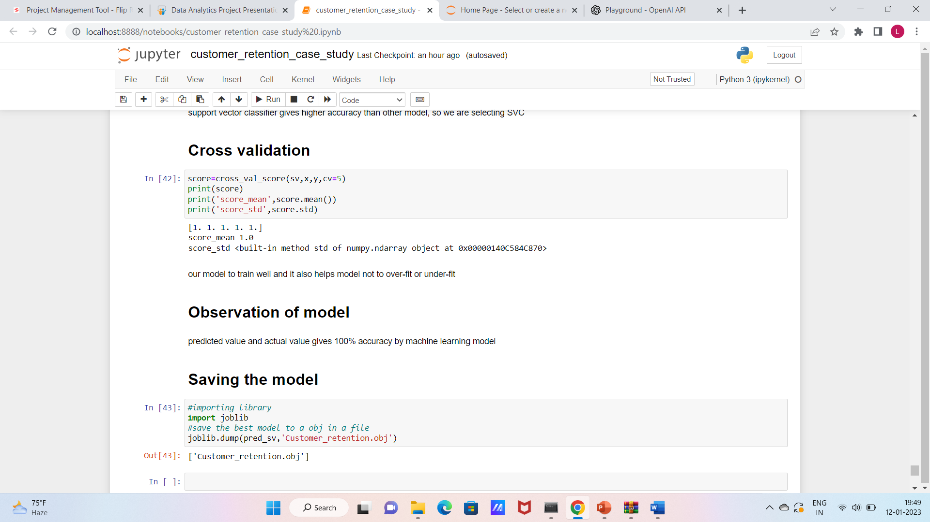
Cross validation
After checking cross val score it is observed that it is works best for svc and has no underfitting and overfitting

Slide 48

Saving the model

Slide 49
Conclusion of model
predicted value and actual value gives 100% accuracy by machine learning model

